Slide 1



Radiation Oncology
Advanced PET imaging
for potentially breakthrough
functional image-guided radiotherapy applications
Yiping Shao
Division of Medical Physics and Engineering
Department of Radiation Oncology
University of Texas Southwestern Medical Center
Radiology Research Day 2021 Nov 17, 2021

Slide 2
Introduction
Lab: Nuclear Imaging Technology Development and Application Lab
Research focus: Develop and apply advanced PET imaging technology to enable novel functional image-guided
photon and particle radiotherapy applications
Outline: Three research projects we are working on:
Develop PET to expand the small animal RT research capability
Apply on-line PET imaging for improving particle (e.g. proton) therapy accuracy
Investigate using TOF PET to enable practical real-time marker-less tumor motion tracking - with targeted performance far beyond Reflexion’s X1 PET-Linac
Current technologies
Existing technical gaps that impede the new and novel clinical/preclinical RT applications
New technologies we are developing to fill the gaps and enable the new and novel RT applications

Slide 3
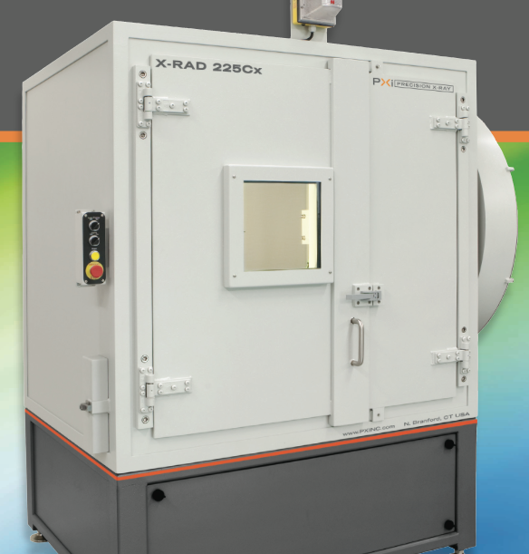
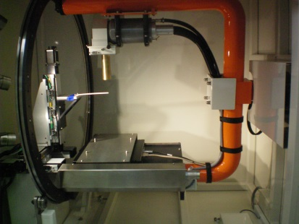
Integrated small animal PET/CT/RT for preclinical radiation research
Current technology:
X-ray tube
moving bed
X-ray detector
Technical gap:
CT image guidance only
No PET functional image guidance

Slide 4
Potential solutions
Separated PET/CT and CT/RT
Integrated PET/CT/RT
Logistical issues
Image co-registration
Limited imaging options
Onboard imaging for high precision
Streamline imaging/radiation processes
Dynamic imaging & motion-compensation
Notes:
I am gonna start off by introducing our project,
which is to embed a high-resolution PET into a small animal irradiator. So that researchers can do PET/CT imaging and radiation treatment in a same machine.
Without moving the couch and the animal from one site to another, the position change of organs and tissues is reduced and also to minimize the realignment error.

Slide 5
New enabling technology
Development of an insert PET
(Compact and lightweight)
Integrate PET with CT/RT
Evaluate PET/CT/RT
X-ray tube
PET
Linear stage
moving bed
X-ray detector

Slide 6
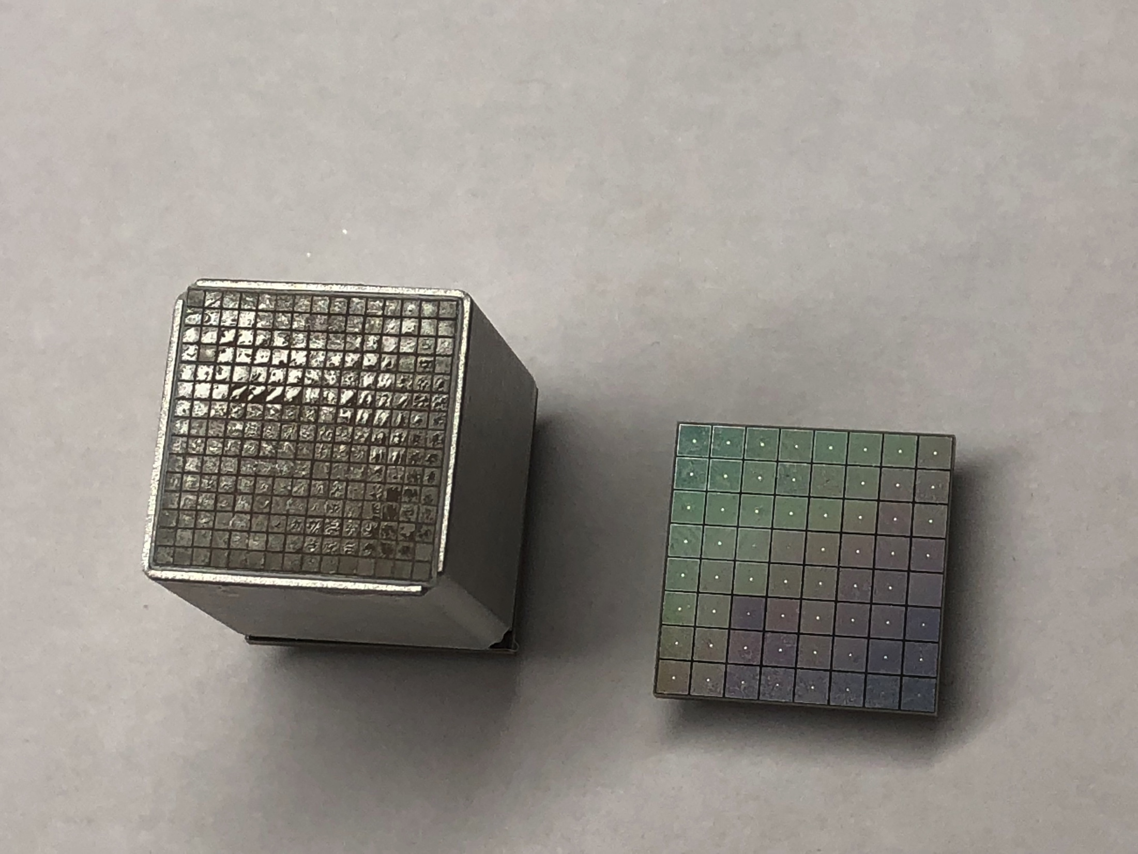
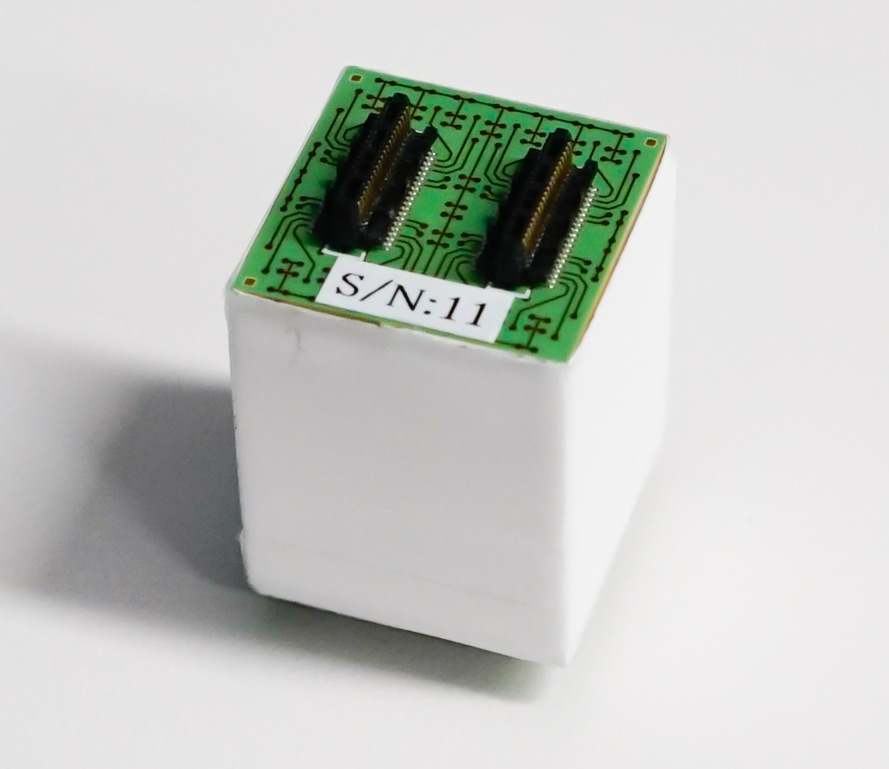
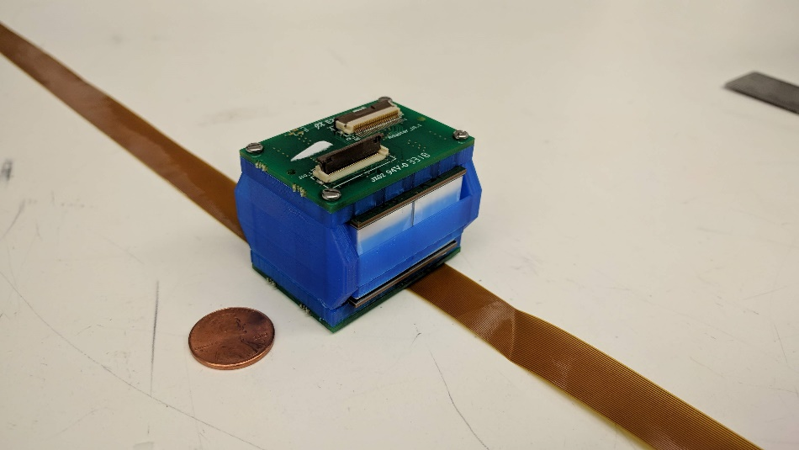
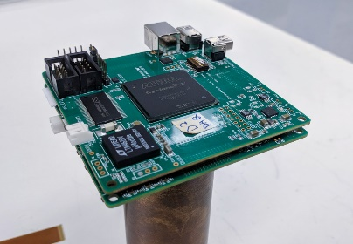
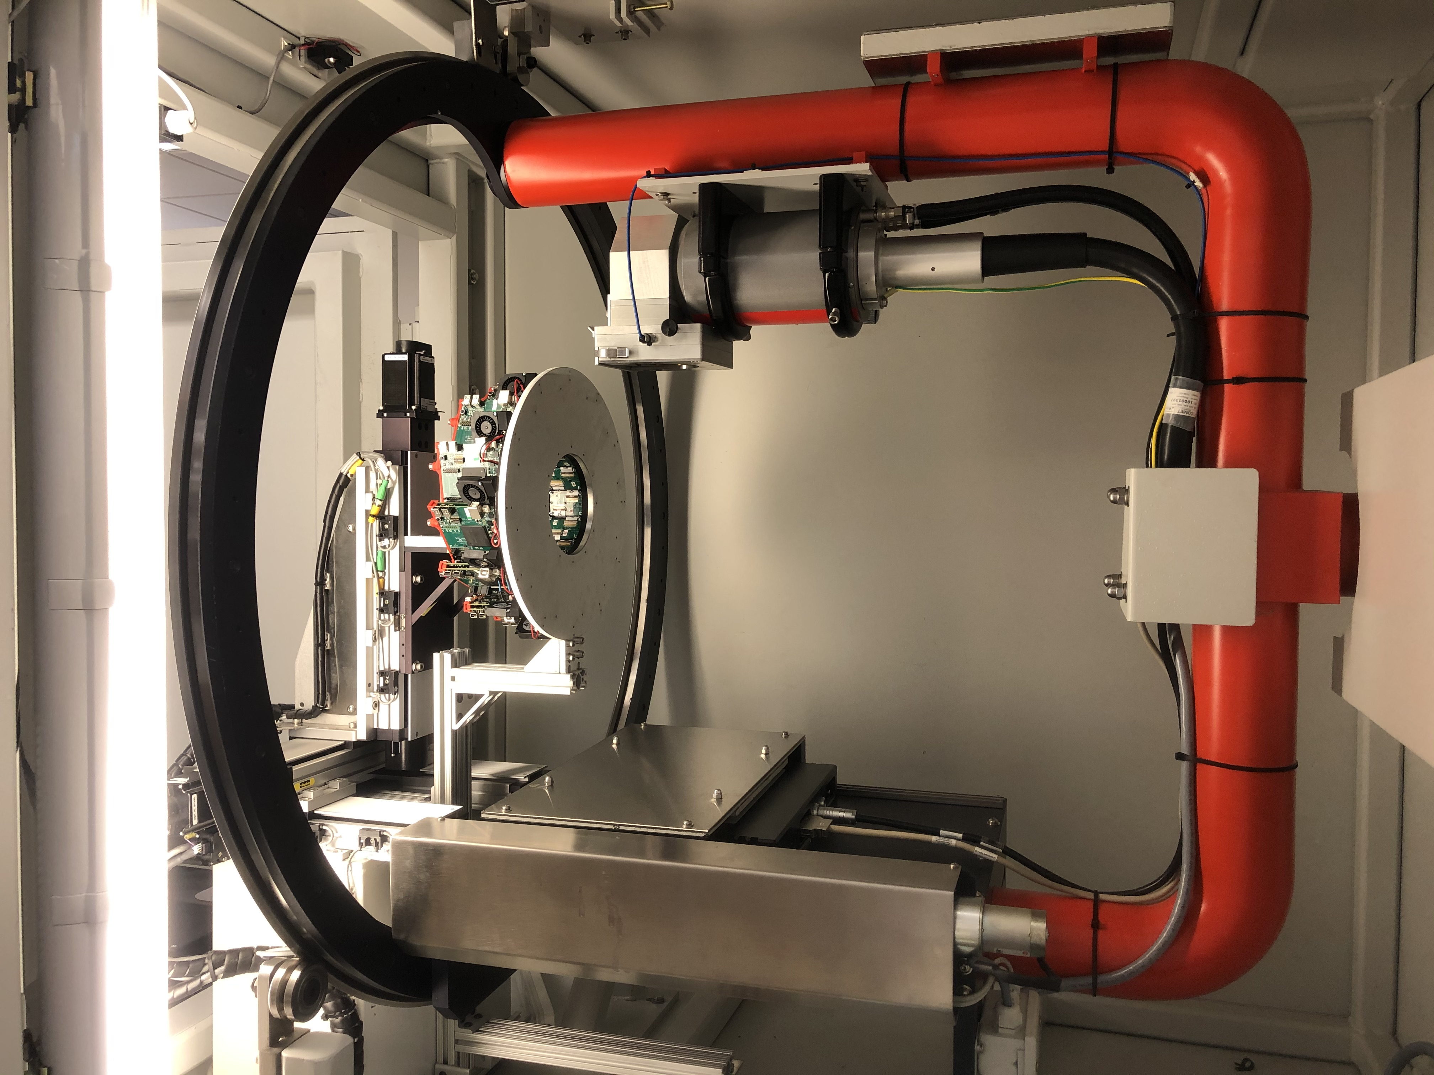
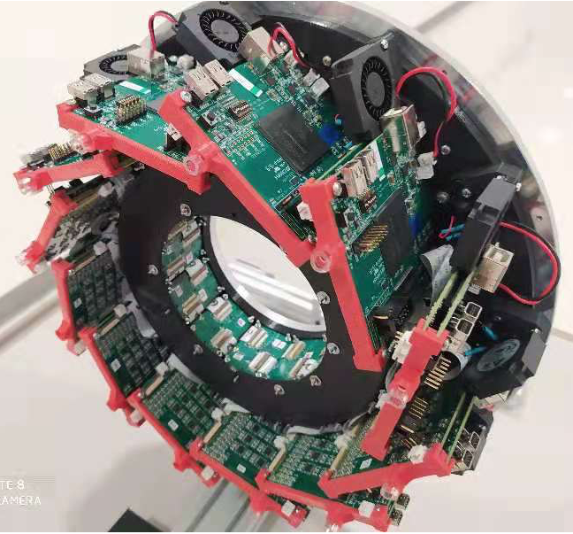
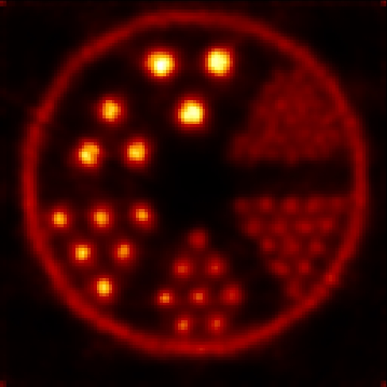
Scintillator array
detector
A PET detector panel
Readout electronics
Image FOV: 8cm & 3.5cm
Light weight: 6.5 kg
PET phantom image
2.4
X-ray tube
2.0
0.75
PET
X-ray detector
1.7
1.0 mm
1.35

Slide 7
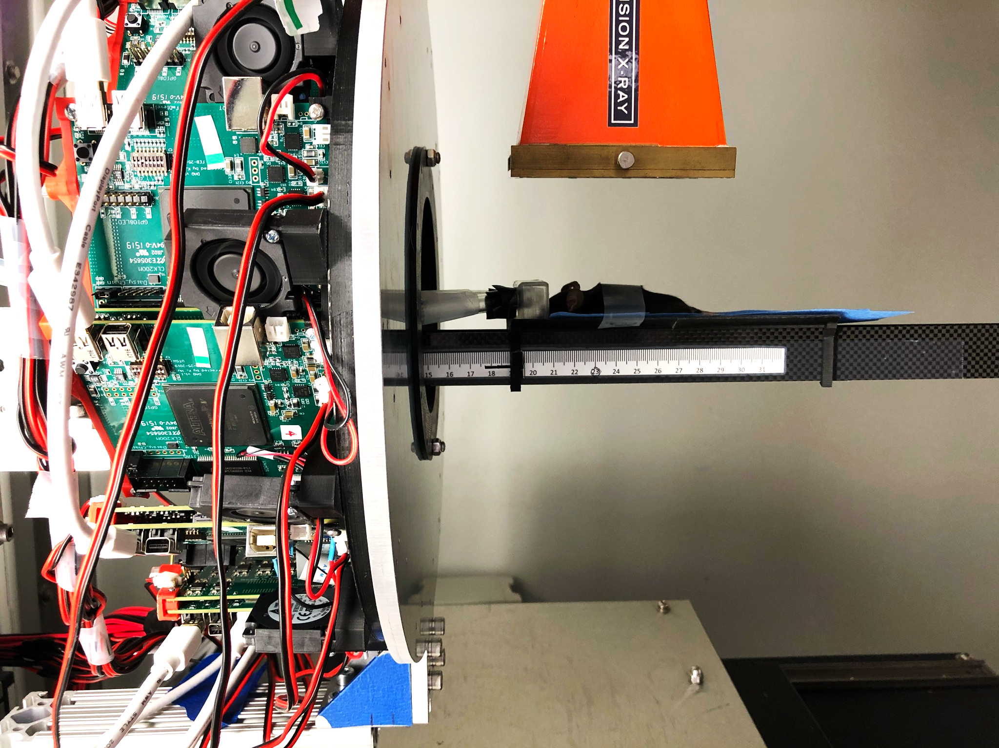
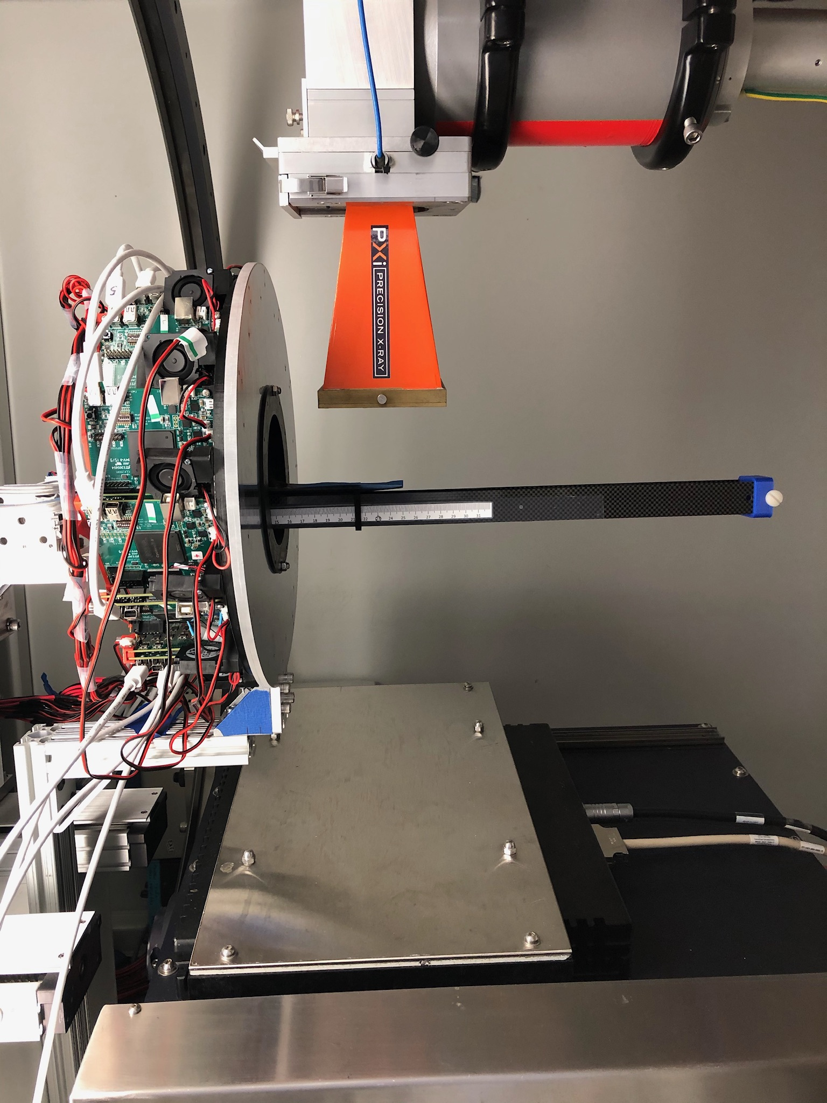
CT acquisition
PET acquisition
mouse
Mouse with ~21 g weight
Subcutaneous injected tumor cell at the thigh
Tumor size ~3.9 mm diameter and ~7.1 mm long
~5.6 kBq ¹⁸FDG injection, 30 min uptake, ~25 min acquisition

Slide 8
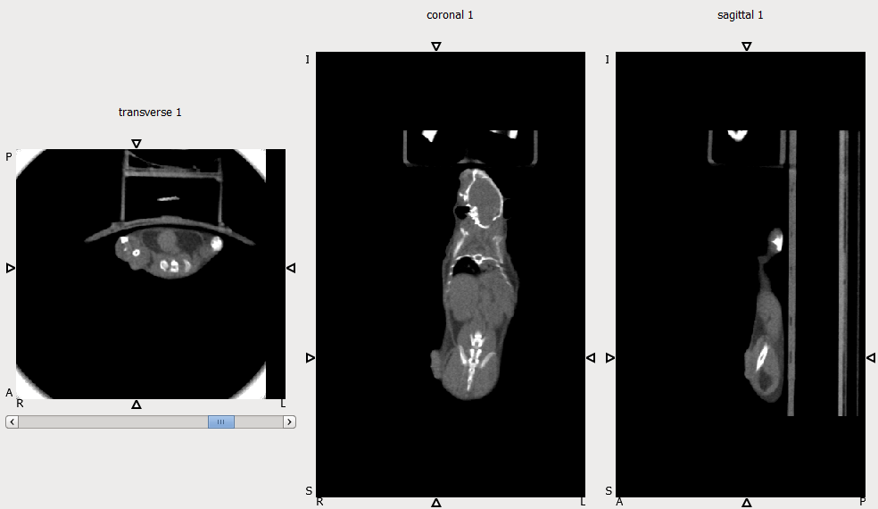
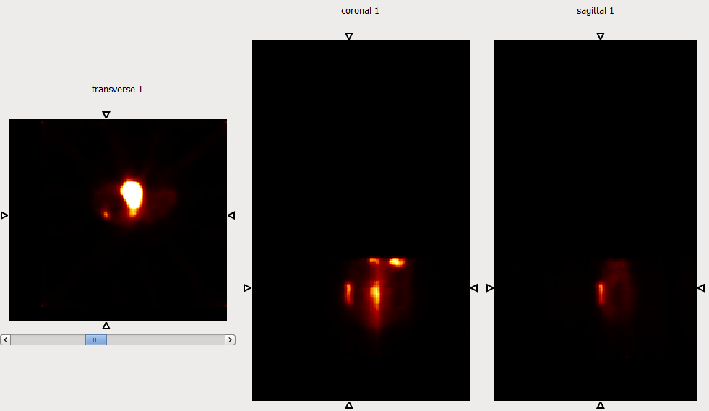
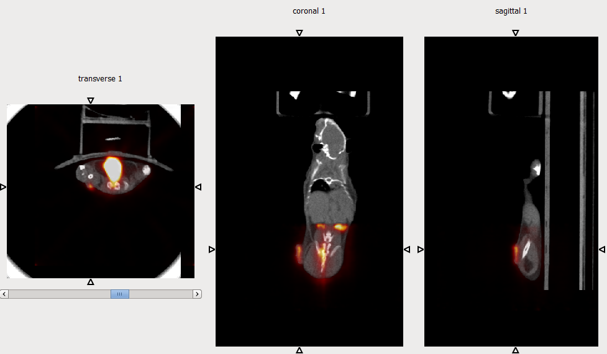
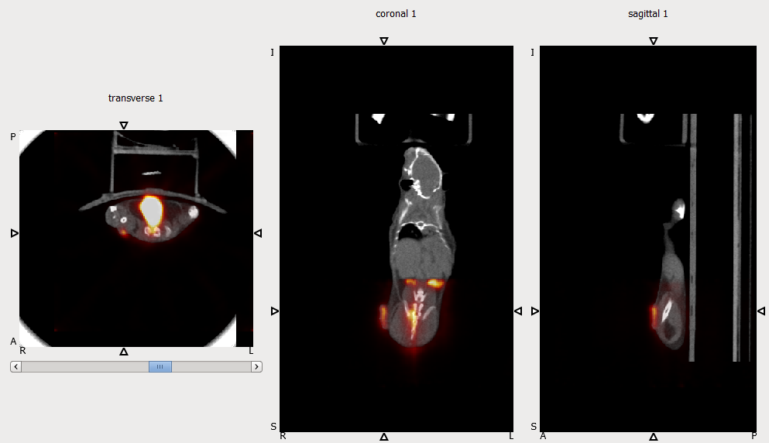
Onboard CT, PET and PET/CT images
(trans-axial view)
(coronal view)
(sagittal view)

Slide 9
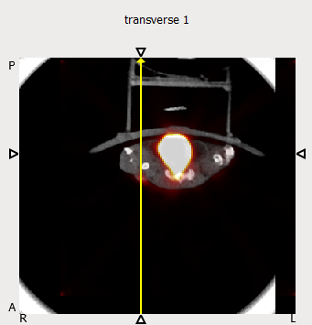
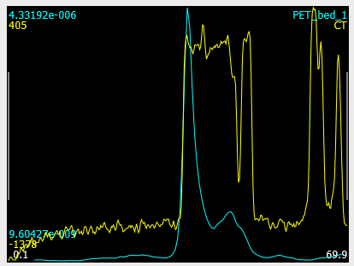
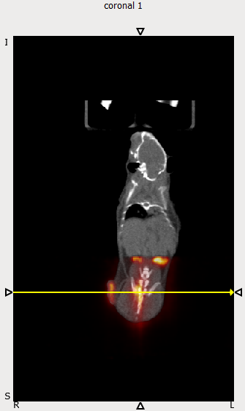
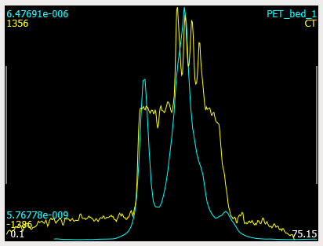
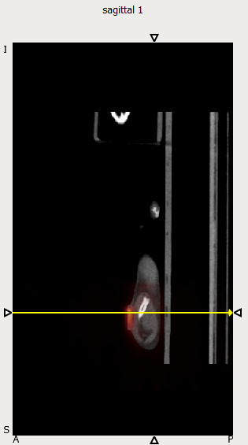
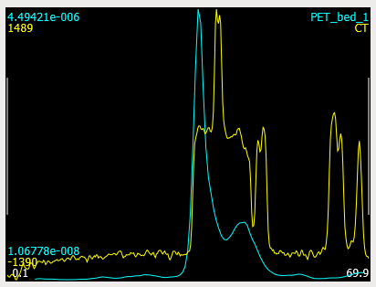
Image line profiles

Slide 10
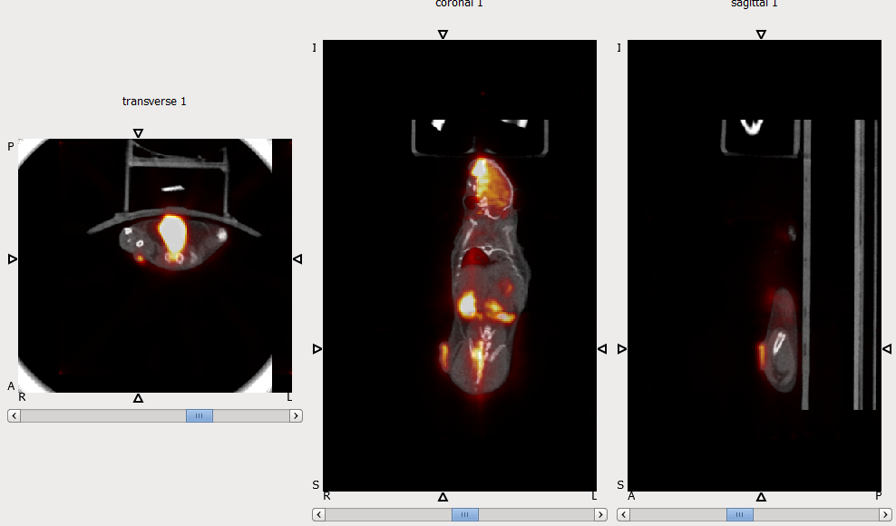
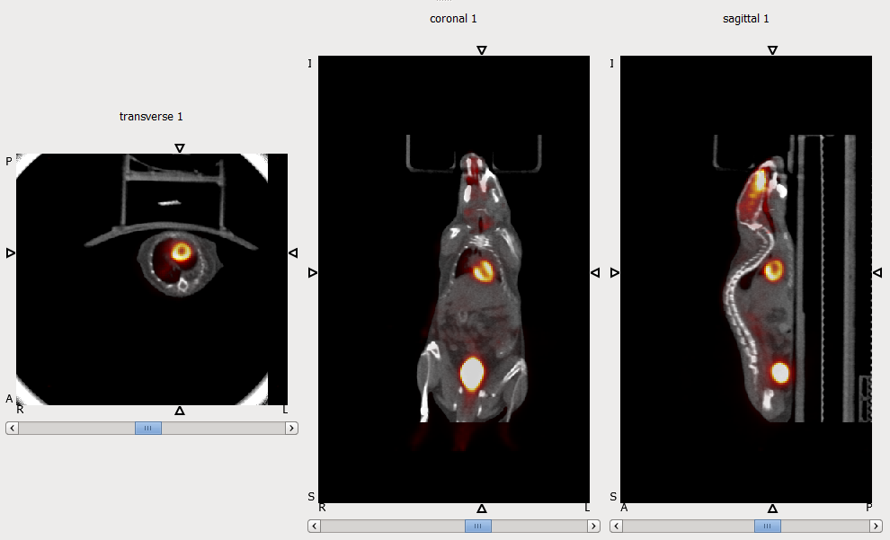
Whole-body animal PET/CT images

